Slide 1
CSE3001 SOFTWARE ENGINEERING PROJECT NAME - EXAMTANTRA
DEEPANSH TRIPATHI
SRIHARAN RAJKUMAR
VISHNU MENON

Slide 2
INTRODUCTION
The “Online Examination Management System” has been developed to override the problems prevailing in the practicing manual system. The software is supported to eliminate and in some cases reduce the hardships faced by this existing system.
This system can lead to an error free, secure, reliable and fast management system. It can assist the user to concentrate on their other activities rather to concentrate on the record keeping.

Slide 3
SCOPE
The goal of the exam management system is to make it easier to administer exams and to create a convenient and easy-to-use application for teachers who are attempting to administer exams. The system is built around a relational database with result management capabilities. We will have a question bank with ten unique questions, their options, and the correct answer, as well as a variable number of students and their information. We aim to provide a pleasant and trustworthy user experience in addition to getting student results.

Slide 4
Programming languages used in the project
FRONT-END SOFTWARE
JAVA NETBEANS - We chose the JAVA our primary programming language to implement the project because of its more interactive capabilities.

Slide 5
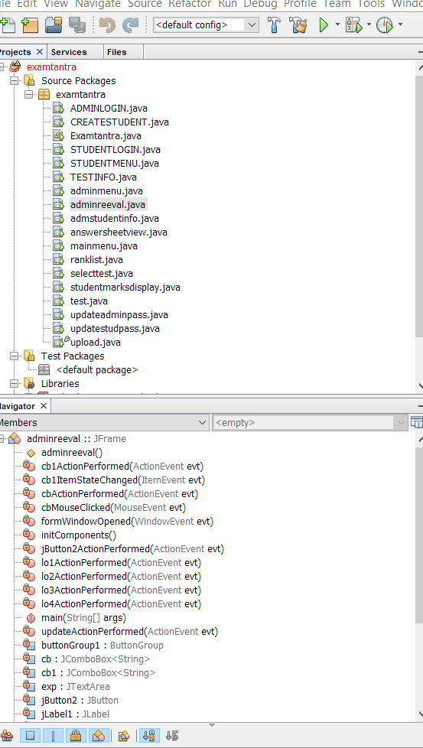
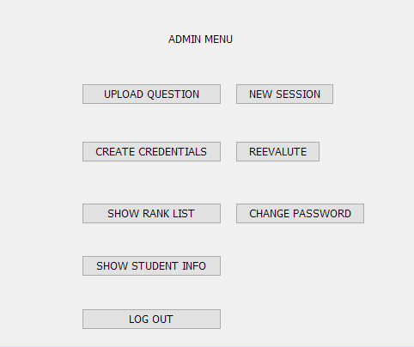
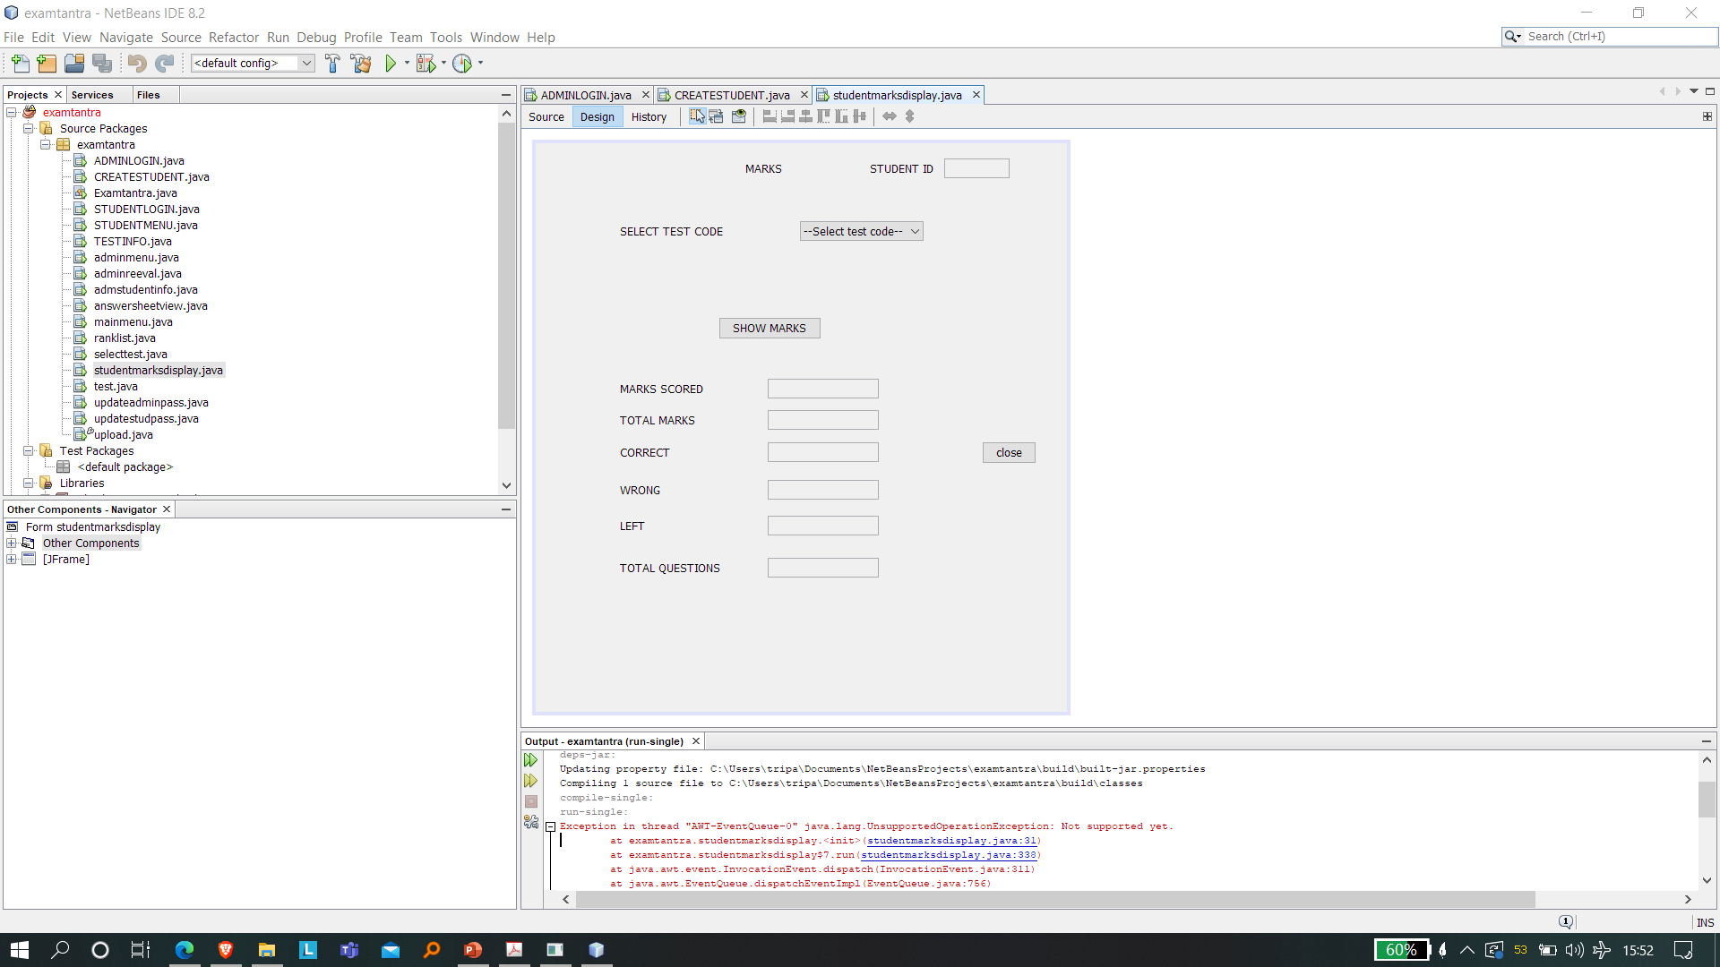
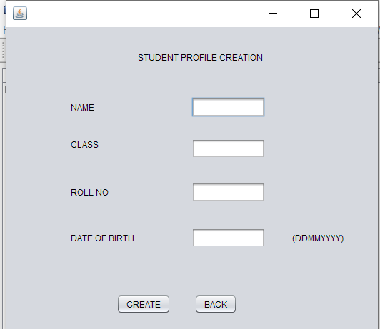
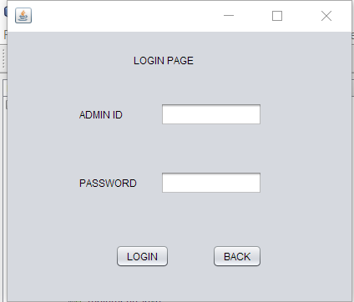
Some screenshots

Slide 6
BACK-END SOFTWARE
MYSQL - MySQL is a relational database management system based on SQL – Structured Query Language. We have used MYSQL database to save student records, teacher records, and question papers, as well as their answers and students' responses.

Slide 7
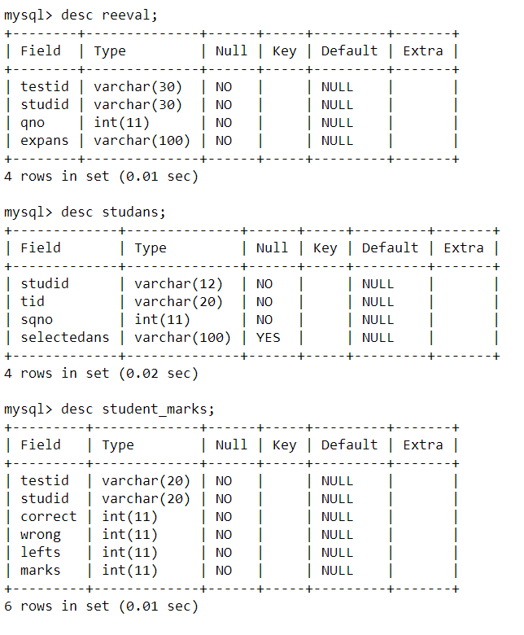
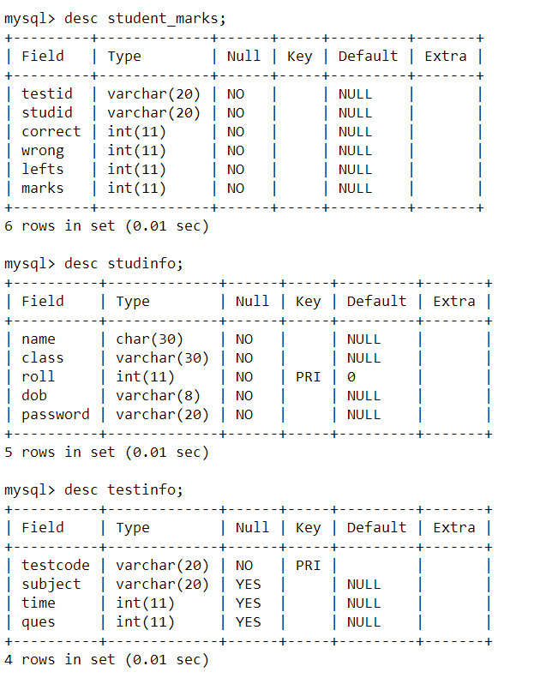
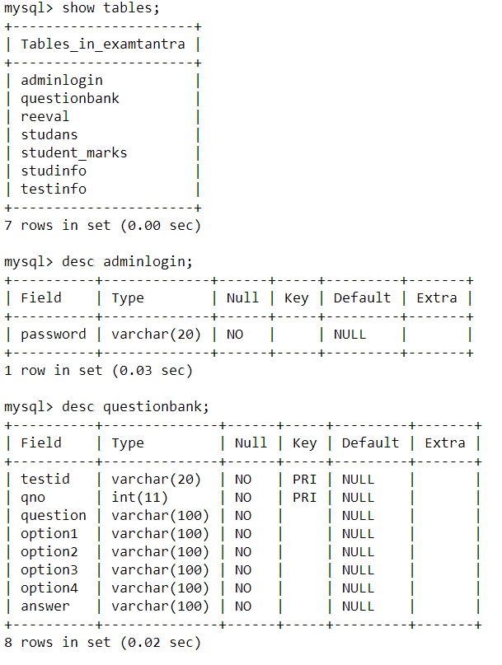
SOME SCREENSHOTS

Slide 8
conclusion
This project aids teachers in the process of administering online examinations with ease.. The scope of the project was to make it easier to administer exams and to create a convenient and easy-to-use application for teachers who are attempting to administer exams and this project accomplishes just that. It is easy to use, fast and leads to less errors.

